Slide 1
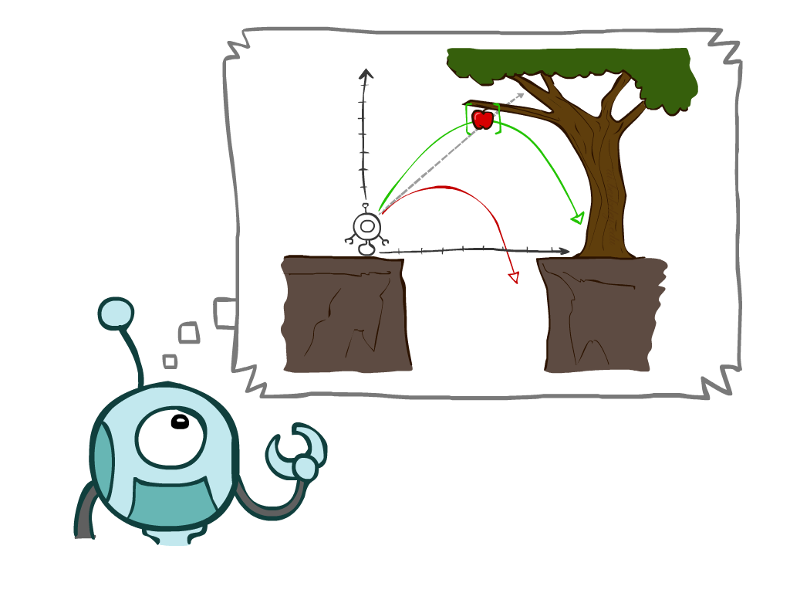
Intelligent Agents
Slide credits: AI BERKELEY

Slide 2
Agent
An agent is anything that can observe its environment, make decisions, and perform actions to achieve a goal.
In Artificial Intelligence, an agent does not have to be a robot. It can be:
  A software program
  A chatbot
  A self-driving car
  A robot
  A game-playing AI
The key idea is:
  An agent perceives → thinks (reason) → acts.

Slide 3
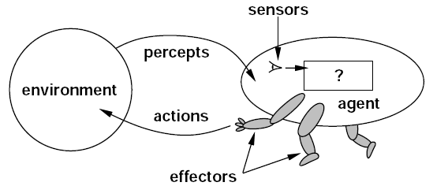
What is an Agent?
Agent:
  Perceives (through sensors)
  Acts (through actuators)
  Reasons (chooses the best action)
“Intelligent agents continuously perform three functions: perception of dynamic conditions in the environment; action to affect conditions in the environment; and reasoning to interpret perceptions, solve problems, draw inferences, and determine actions.”

Slide 4
1. Percept
Percept refers to the agent's perceptual inputs at any given instant.
  What the agent sees right now.
  Human Example
    Sensors include:
    Eyes
    Ears
    Nose
    Skin
    Tongue
AI Examples
Agent | Sensors
Self-driving car | Cameras, LiDAR, Radar, GPS
Robot vacuum | Infrared sensors, cameras
Chess AI | Current board position
ChatGPT | User's text prompt

Slide 5
Percept Sequence
Percept sequence: the complete history of everything the agent has ever perceived
  Everything it has seen so far
A self-driving car:
  Percept = “Red light”
  Percept sequence = “Green → Yellow → Red”
The action depends on the whole percept sequence, not just current input.

Slide 6
2. Reasoning (think)
After collecting information, the agent decides what to do, this is called reasoning.
Reasoning may involve:
  Applying rules
  Searching
  Planning
  Learning
  Comparing alternatives
  Predicting outcomes
The goal is to choose the best possible action.
→Example:
  A GPS navigation system considers:
    Distance
    Traffic
    Road closures
  Then it selects the fastest route.

Slide 7
3. Action
Finally, the agent performs an action using actuators (effectors).
  Human Actuators
    Hands
    Legs
    Voice
  Robot Actuators
    Wheels
    Motors
    Robotic arms
    Speakers
Examples:
  Robot moves forward.
  ChatGPT generates a response.
  Self-driving car turns left.
  Vacuum cleaner changes direction.

Slide 8
Intelligent Agents
An intelligent agent may learn from the environment to achieve their goals.
Following are the main four rules for an AI agent:
  Rule 1: An AI agent must have the ability to perceive the environment.
  Rule 2: The observation must be used to make decisions.
  Rule 3: Decision should result in an action.
  Rule 4: The action taken by an AI agent must be a rational action.

Slide 9
Example of Agents
Human Agent
  eyes, ears, skin, taste buds, etc. for sensors
  hands, fingers, legs, mouth, etc. for actuators
Robot
  camera, infrared, etc. for sensors
  grippers, wheels, speakers, etc. for actuators
Software Agent
  functions as sensors
    information provided as input to functions in the form of encoded bit strings or symbols
  functions as actuators
    results deliver the output

Slide 10
Rational Agent
Rational Agent:
  A rational agent is an agent that chooses the action expected to produce the best outcome based on:
    What it has perceived so far (percept sequence).
    What it already knows.
    The actions available to it.
  A rational agent simply makes the best possible decision with the information currently available.
Rationality is distinct from omniscience (all-knowing with infinite knowledge)
  Actual (perfection) vs. Expected
  Best vs. Optimal

Slide 11
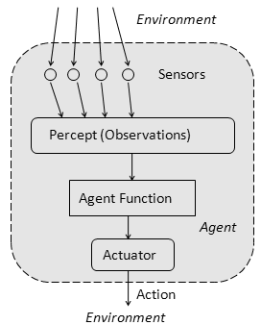
Agent Function and Program
Behavior of Agent − It is the action that agent performs after any given sequence of percepts
Agent’s behavior is mathematically described by Agent function
  A function mapping any given percept sequence to an action
Practically it is described by agent program
  The code that implements the agent function mapping
Problems:
  what is “the right thing”
  how do you measure the “best outcome”

Slide 12
Specifying the Task Environment
Performance of Agents

Slide 13
Performance of Agents
Before designing an AI system, we must define the task environment using PEAS.
PEAS:
  Performance measure
    Defines how success of the agent is evaluated.
  Environment
    The external world in which the agent operates.
  Actuators
    The mechanisms through which the agent takes actions.
  Sensors
    The devices or inputs through which the agent perceives the environment.

Slide 14
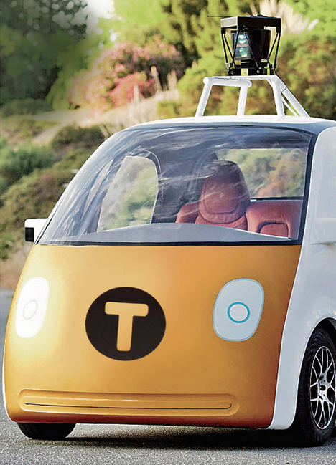
PEAS: Automated Taxi
Performance measure
  Correct Destination, Fuel, time, cost, violations, safety, comfort, profit
Environment
  Roads, traffic
Actuators
  Steering, brake
Sensors
  Camera, radar, engine sensors

Slide 15
PEAS: Food Delivery Robot
What would be the PEAS for a Food Delivery Robot?
Performance Measure: Deliver correct food to the correct customer quickly, safely, and with minimal cost.
Environment: Streets, sidewalks, traffic, pedestrians, weather conditions, restaurants, and customers.
Actuators: Wheels/motors, robotic arm (if any), display/speaker for communication.
Sensors: Camera, GPS, proximity sensors, obstacle detectors, microphone (optional).

Slide 16
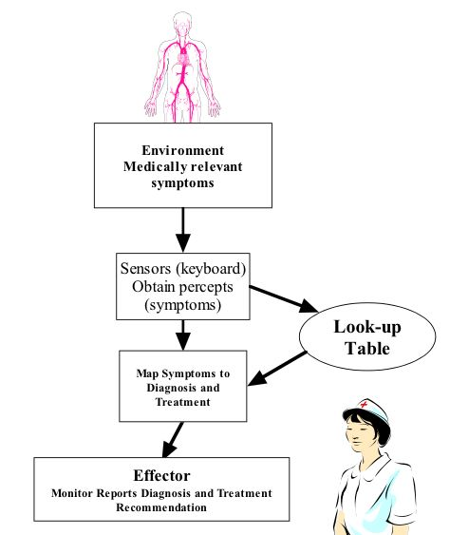
PEAS: Medical diagnosis system
Performance measure:
  Healthy patient, minimize costs, lawsuits
Environment:
  Patient, hospital, staff
Actuators:
  Screen display (questions, tests, diagnoses, treatments, referrals)
Sensors:
  Keyboard (entry of symptoms, findings, patient's answers)

Slide 17
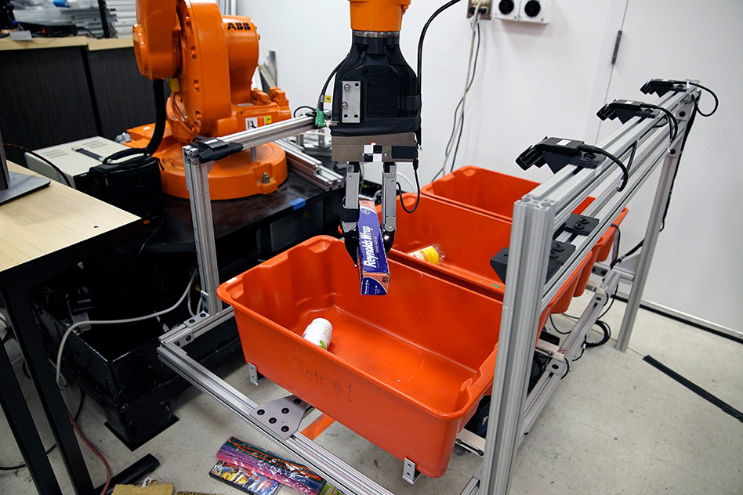
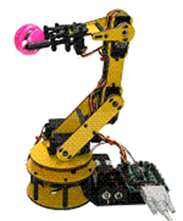
PEAS: Part-picking robot
Performance measure:
  Percentage of parts in correct bins
Environment:
  Conveyor belt with parts, bins
Actuators:
  Jointed arm and hand
Sensors:
  Camera, joint angle sensors

Slide 18
PEAS: Interactive English tutor
Activity
Performance measure:
  Maximize student's score on test
Environment:
  Set of students
Actuators:
  Screen display (exercises, suggestions, corrections)
Sensors:
  Keyboard

Slide 19
Environment Types

Slide 20
Properties of environments
Fully observable (Accessible) vs. partially observable (Inaccessible)
  Fully Observable (Accessible):
    The agent can perceive the complete state of the environment at each time step.
  Partially Observable (Inaccessible):
    The agent cannot perceive the complete state of the environment.
  Example:
    Chess → Fully observable (you see entire board)
    Poker → Partially observable (you don’t see opponent’s cards)
  Is the current state of the world fully known at each step?

Slide 21
Properties of environments
Deterministic vs. nondeterministic (Stochastic).
  Deterministic → next state can be determined
  Stochastic → Randomness involved
  If the next state of the environment is completely determined by the current state and the actions selected by the agents, then we say the environment is deterministic.
  If the environment is inaccessible, then it may appear to be nondeterministic (bunch of uncertainties).
  Example:
  Chess → deterministic
  Taxi driving → stochastic

Slide 22
Environment Types
Episodic vs. Sequential:
  Episodic: If each decision is independent and does not influence future decisions, the environment is episodic.
  The choice of action in each episode depends only on the episode itself.
  Sequential: Current action affects future (Chess)
Example (Episodic): Email Spam Filter
  Each email is handled independently.
  The agent reads one email (percept).
  Classifies it as spam or not spam (action).
  Moves to the next email.
  The decision for one email does not affect the next one
Example (Sequential): Self-Driving Car
  If the car takes wrong turn now:
  → It affects arrival time
  → It affects fuel usage
  → It affects future route options

Slide 23
Environment Types
Static vs. Dynamic:
  If the environment can change while an agent is performing action, then we say the environment is dynamic for that agent; otherwise, it is static.
  Dynamic environments are continuously asking the agent what it wants to do
  Static environments are easy to deal with, because the agent does not keep on looking at the environment while it is deciding on an action.
  Example:
    Taxi → Dynamic
    Crossword → Static

Slide 24
Environment Types
Discrete vs. continuous:
  Is there a finite (or countable) number of possible environment states?
  The environment is discrete if the number of actions and possible states of the environment is finite otherwise it is continuous.
  If there are a limited number of distinct, clearly defined percepts and actions, we say that the environment is discrete.
    Chess, since there are a fixed number of possible moves on each turn.
    Taxi driving is continuous.

Slide 25
Types of Environment
Single Agent vs. Multi Agent
  Is the agent the only thing acting in the world?
  In the single agent environment, there is only one agent
    A computer software playing crossword puzzle
  In multi-agent systems, there are more than one active agents
    Video games

Slide 26
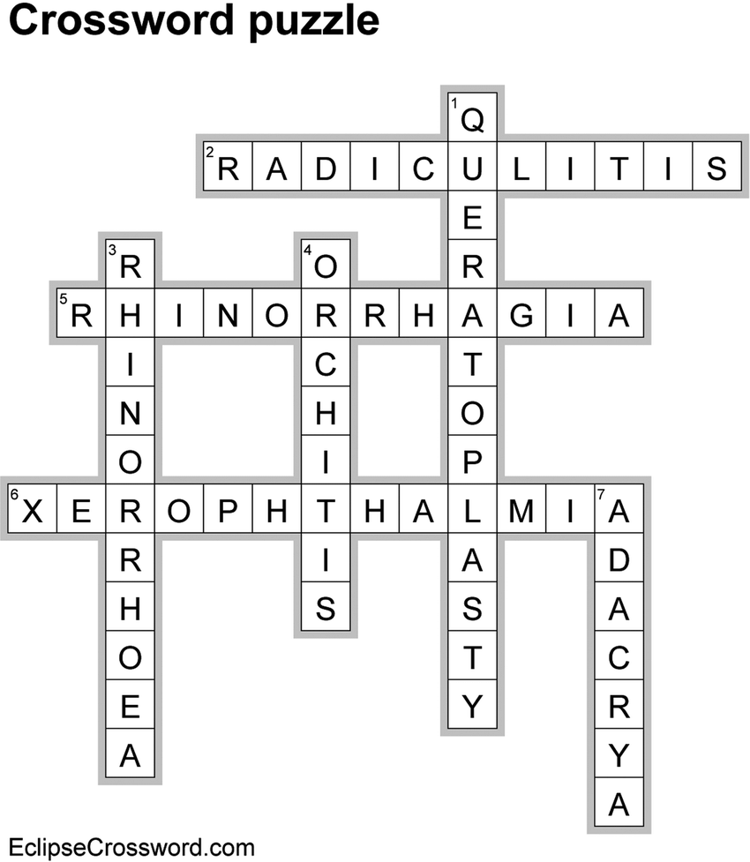
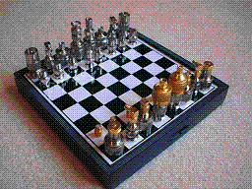


Environment Types Example
Crossword puzzle
Chess
Taxi driving
Part-picking robot
English tutor
Observable
Yes
Yes
No
No
No
Deterministic
Yes
Yes
No
No
No
Episodic
No
No
No
Yes
No
Static
Yes
Yes
No
No
No
Discrete
Yes
Yes
No
No
Yes
Agents
Single
Multi
Multi
Single
Multi

Slide 27
Structure of Agents

Slide 28
Agent design
The environment type largely determines the agent design
  Fully/partially observable => agent requires memory (internal state)
  Discrete/continuous => agent may not be able to enumerate all states
  Stochastic/deterministic => agent may have to prepare for contingencies
  Single-agent/multi-agent => agent may need to behave randomly

Slide 29
Skeleton Agent Program
Basic framework for an agent program
function SKELETON-AGENT(percept) returns action
//The agent receives one percept from the environment and must return one action
static: memory
//memory is not reset every time, keeps past information, remembers history
memory := UPDATE-MEMORY(memory, percept)
//the agent updates its internal state using old memory and new percept
action := CHOOSE-BEST-ACTION(memory)
// the agent decides what to do, using its internal memory. This is where rationality happens.
memory := UPDATE-MEMORY(memory, action)
//after choosing action the agent updates its memory again with the latest action.
return action
//Finally the agent performs the action in the environment
Agents

Slide 30
Table Agent Program
agent program based on table lookup
function TABLE-DRIVEN-AGENT(percept) returns action
static: percepts // initially empty sequence*
      table // indexed by percept sequences
      // initially fully specified
append percept to the end of percepts
action := LOOKUP(percepts, table)
return action
* Note: the storage of percepts requires writeable memory
Agents

Slide 31
Structure of Agent
All agents map percepts to actions, but they differ in intelligence level.
Types of agents (increasing in generality and ability to handle complex environments)
  Simple reflex agents
  Model-based reflex agents
    keep track of the world
  Goal-based agents
    work towards a goal
  Utility-based agents
  Learning agent

Slide 32
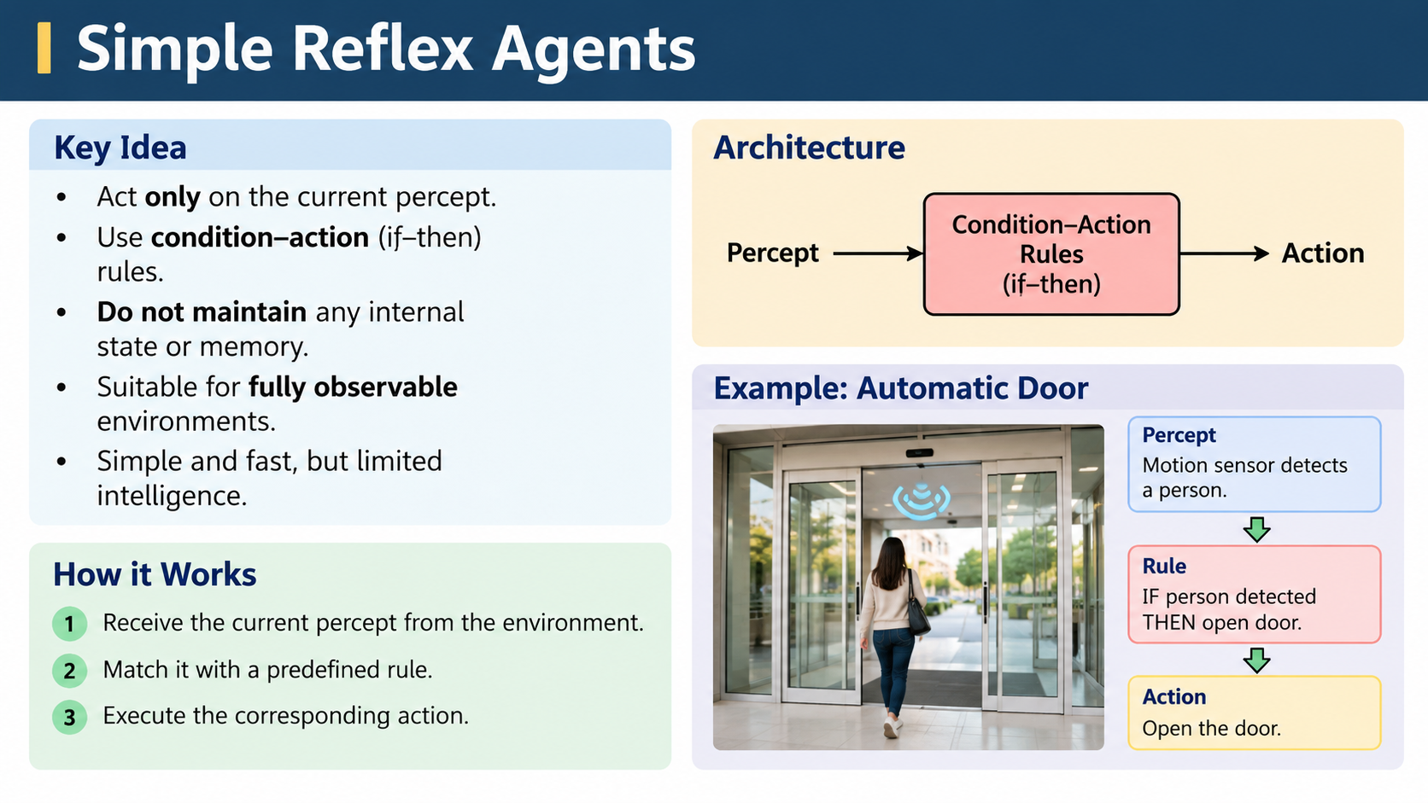

Slide 33
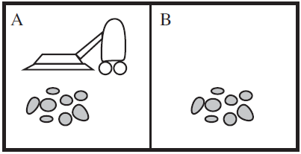
Example: Vacuum Agent
Performance?
  1 point for each square cleaned in time T?
  #clean squares per time step - #moves per time step?
Environment: vacuum, dirt, multiple areas defined by square regions
Actions: left, right, clean, idle
Sensors: location and contents
  [A, dirty]
If status=Dirty then return clean
else if location=A then return Right
else if location=B then return Left

Slide 34
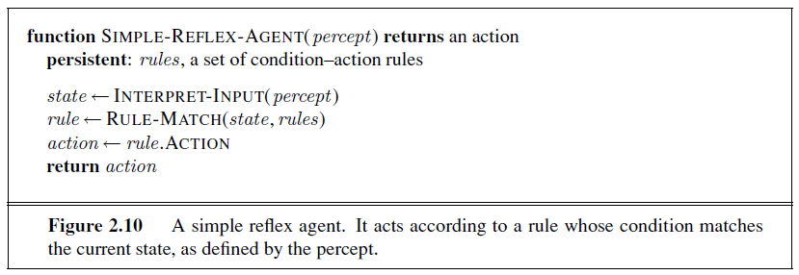
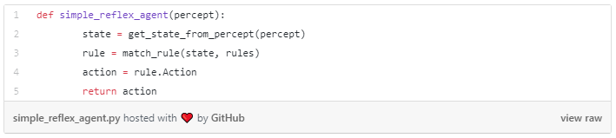
Simple Reflex Agent

Slide 35
Problem with Simple Reflex Agent
Many real-world environments are partially observable.
This means the agent cannot see the entire environment at all times.
Examples:
  A self-driving car cannot see vehicles hidden behind a truck.
  A robot cannot see what is behind a wall.
  A vacuum cleaner cannot see dirt in another room.
  A doctor cannot directly observe everything happening inside a patient's body.
The agent therefore has incomplete information.

Slide 36
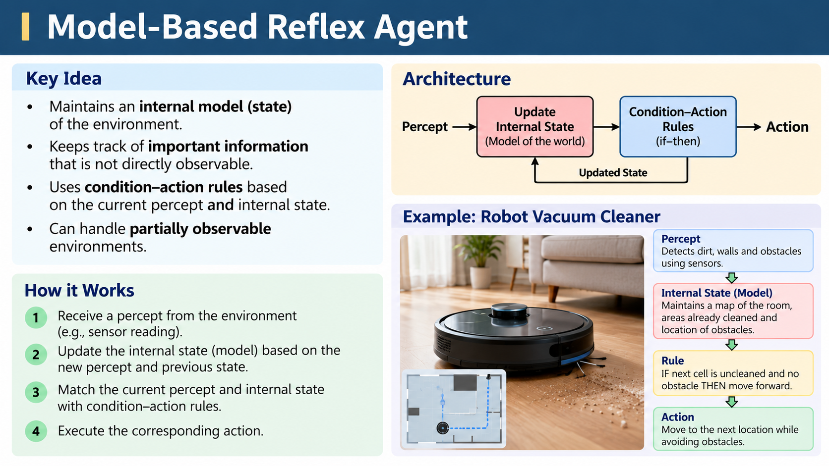

Slide 37
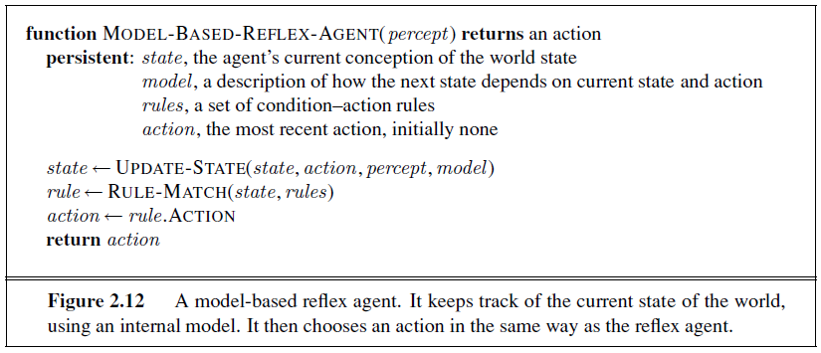
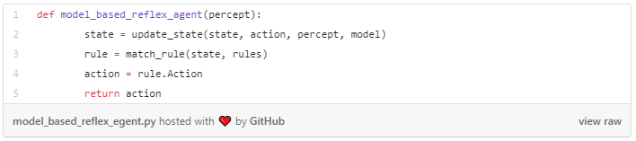
Model-Based Agent

Slide 38
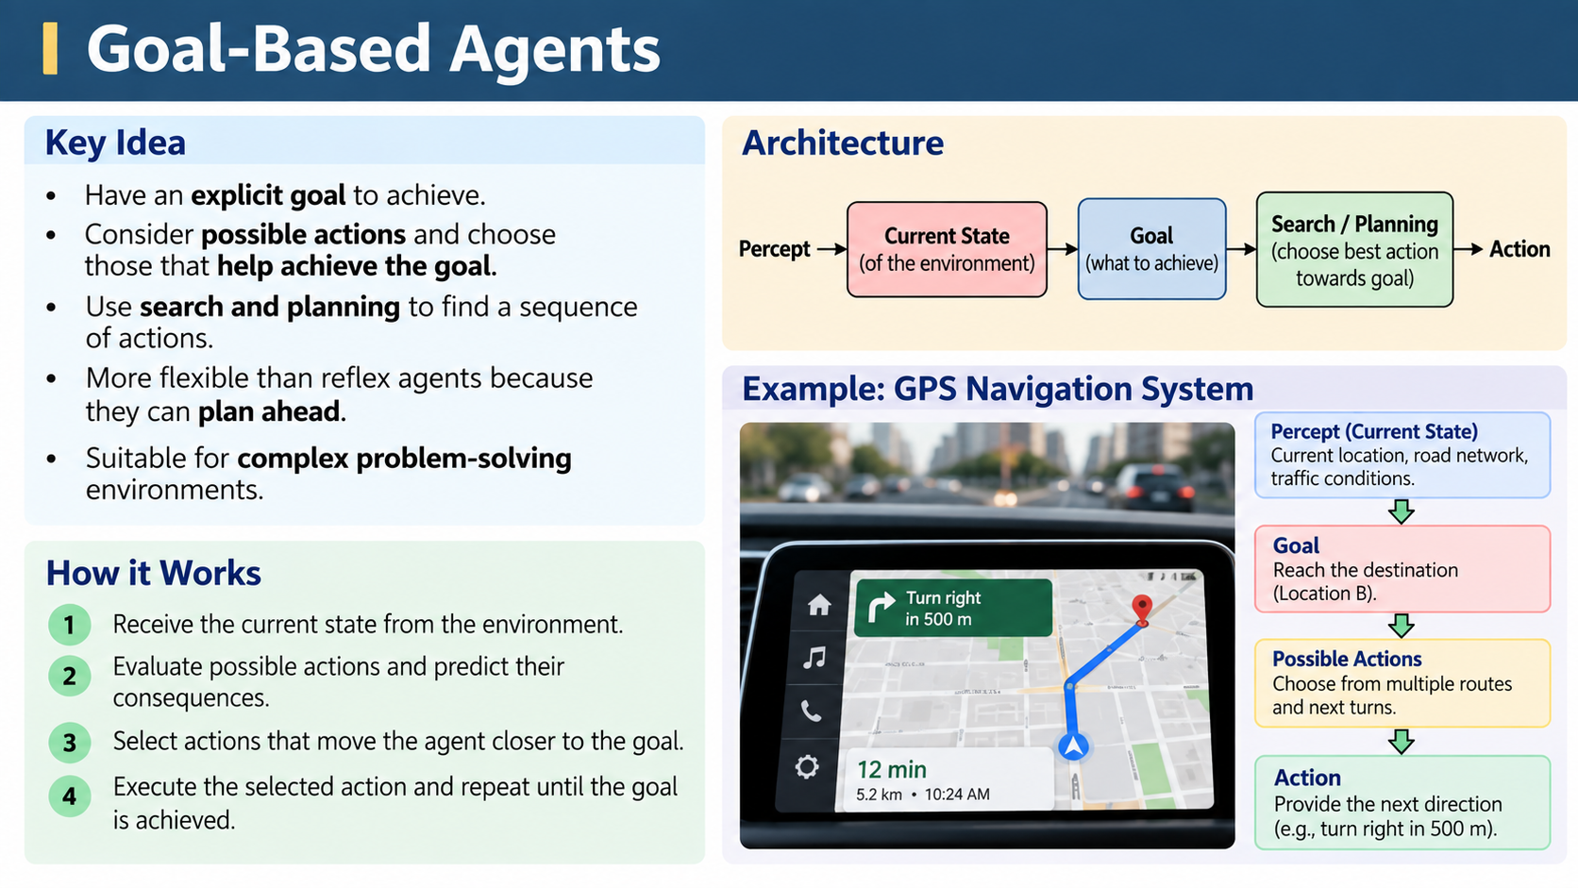

Slide 39
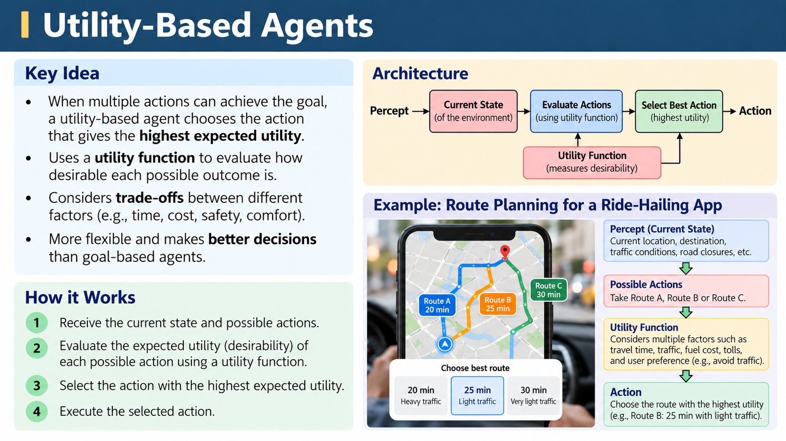

Slide 40
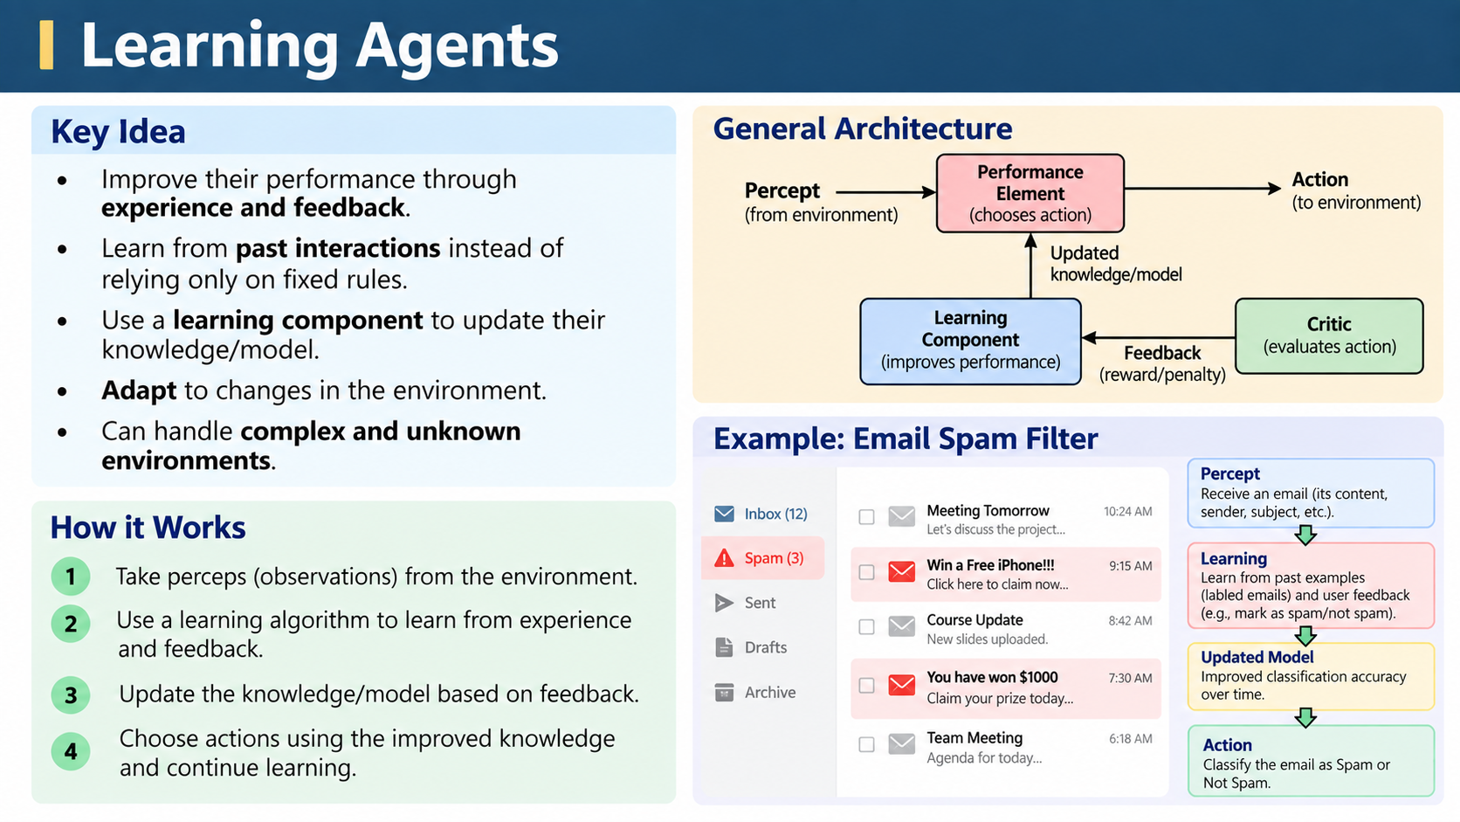

Slide 41
Intelligent Agents
Simple reflex agents respond directly to percepts
model-based reflex agents maintain internal state to track aspects of the world that are not evident in the current percept.
Goal-based agents act to achieve their goals,
utility-based agents try to maximize their own expected “happiness.”
Learning Agents designed to act in uncertain environment

